Slide 1
Knowledge Submission
Name: Rekha Ramtirthkar
Internship Type: Project Based Internship
Date of submission: 12/02/20204

Slide 2
Task
Moodle tool(user manager): How do generate statistics report of user accounts related to how many users are consume which courses.

Slide 3
Moodle(user manager) tool overview
Moodle is a learning platform designed to provide educators, administrators and learners with a single robust, secure and integrated system to create personalized learning environments.
Moodle is a free and open-source learning management system written in PHP and distributed under the GNU General Public License. Moodle is used for blended learning, distance education, flipped classroom and other online learning projects in schools, universities, workplaces and other sectors.

Slide 4
Features of the Moodle:
Designed to support both teaching and learning
With over 10 years of development guided by social constructionist pedagogy, Moodle delivers a powerful set of learner-centric tools and collaborative learning environments that empower both teaching and learning.
Easy to use
A simple interface, drag-and-drop features, and well-documented resources along with ongoing usability improvements make Moodle easy to learn and use.

Slide 5
Free with no licensing fees
Moodle is provided freely as Open Source software, under the GNU General Public License. Anyone can adapt, extend or modify Moodle for both commercial and non-commercial projects without any licensing fees and benefit from the cost-efficiencies, flexibility and other advantages of using Moodle.
Always up-to-date
The Moodle project’s open-source approach means that Moodle is continually being reviewed and improved on to suit the current and evolving needs of its users.
Moodle in your language
Moodle’s multilingual capabilities ensure there are no linguistic limitations to learning online. The Moodle community has begun translating Moodle into more than 120 languages (and counting) so users can easily localize their Moodle site, along with plenty of resources, support and community discussions available in various languages.

Slide 6
Steps taken to do this task:
How to download and install moodle in local server
1. Download moodle source code zip file from google.
2. Extract file.
3. Import the file in local server(wampserver).
4. Call the file through browser.
5. Done required configuration like create database and assign the require software: While doing configuration face so much troubleshooting.
6. Once resolve the troubleshooting related issues the Moodle(user manager) software start working.
7. Create administrator account and create or upload the users.

Slide 7
Steps to enable statistics and generate the graph
Go to site administration/users/upload users then go to courses/create new courses.
Go to site administration/general/advanced features/click enable statistics checkbox .
Right click on enable statistics checkbox, go to inspection and check the in which file code is available.
Go to the same source code file and find the code then make disabled to enabled(like value=0 to 1).
Then go to phpmyadmin and export database.
Open database in editplus and search enablestats, check in which file it is available.
Go to phpmyadmin respected file make enablestats is enable(like 0 to 1)
Then go to site administration/reports/statistics and see in reports in the form of graph.

Slide 8
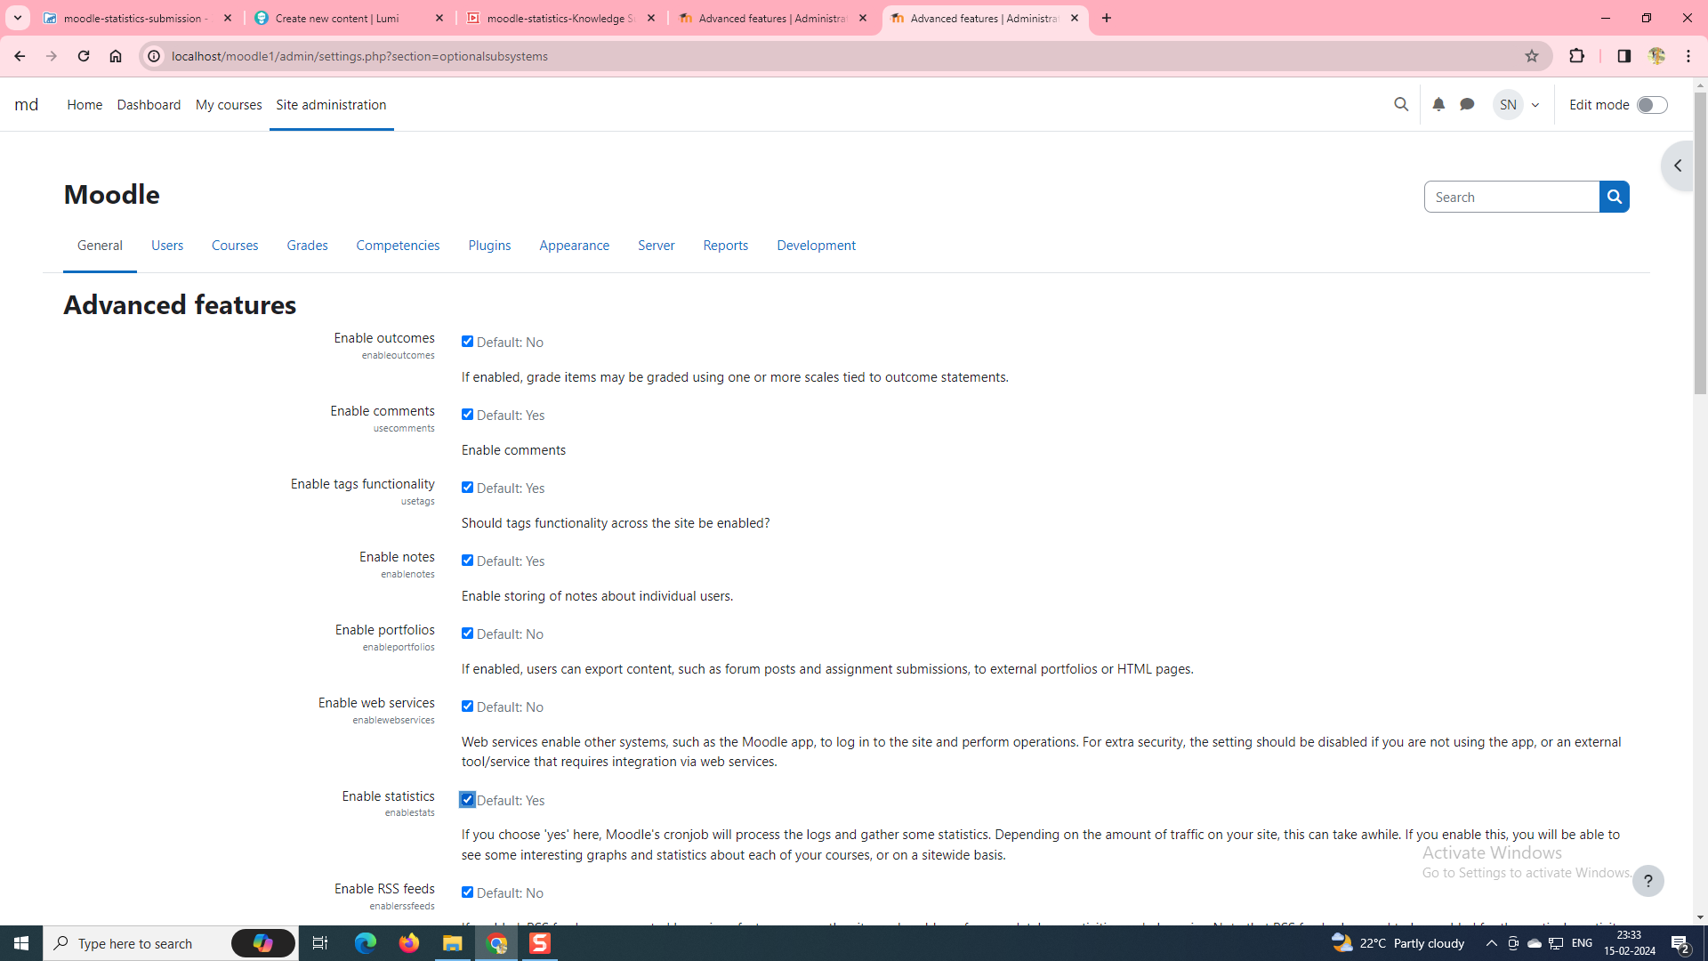
Go to site administration/general/advanced features/click enable statistics checkbox

Slide 9
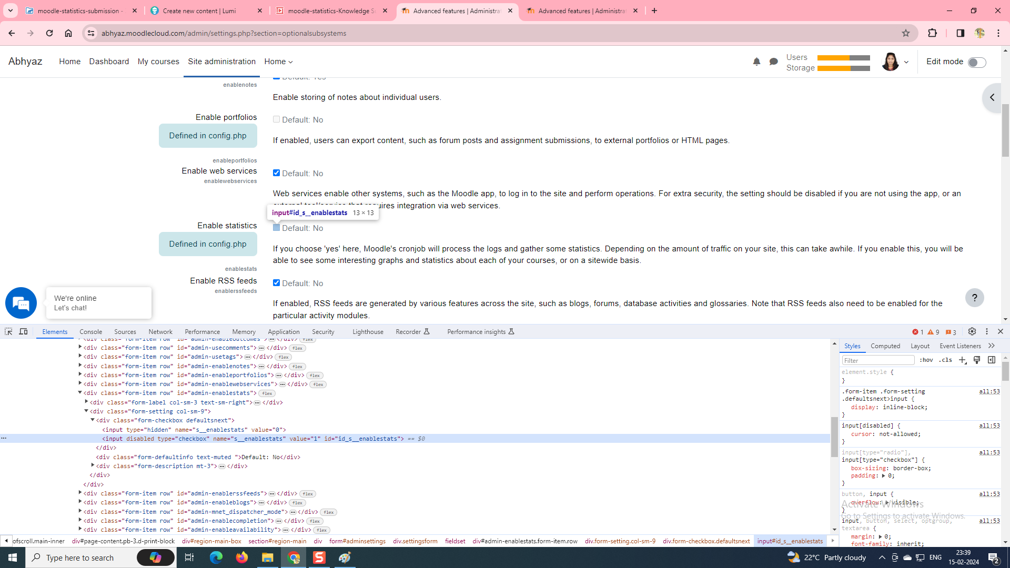
Right click on enable statistics checkbox, go to inspection and check the in which file code is available.
Go to the same source code file and find the code then make disabled to enabled(like value=0 to 1).

Slide 10
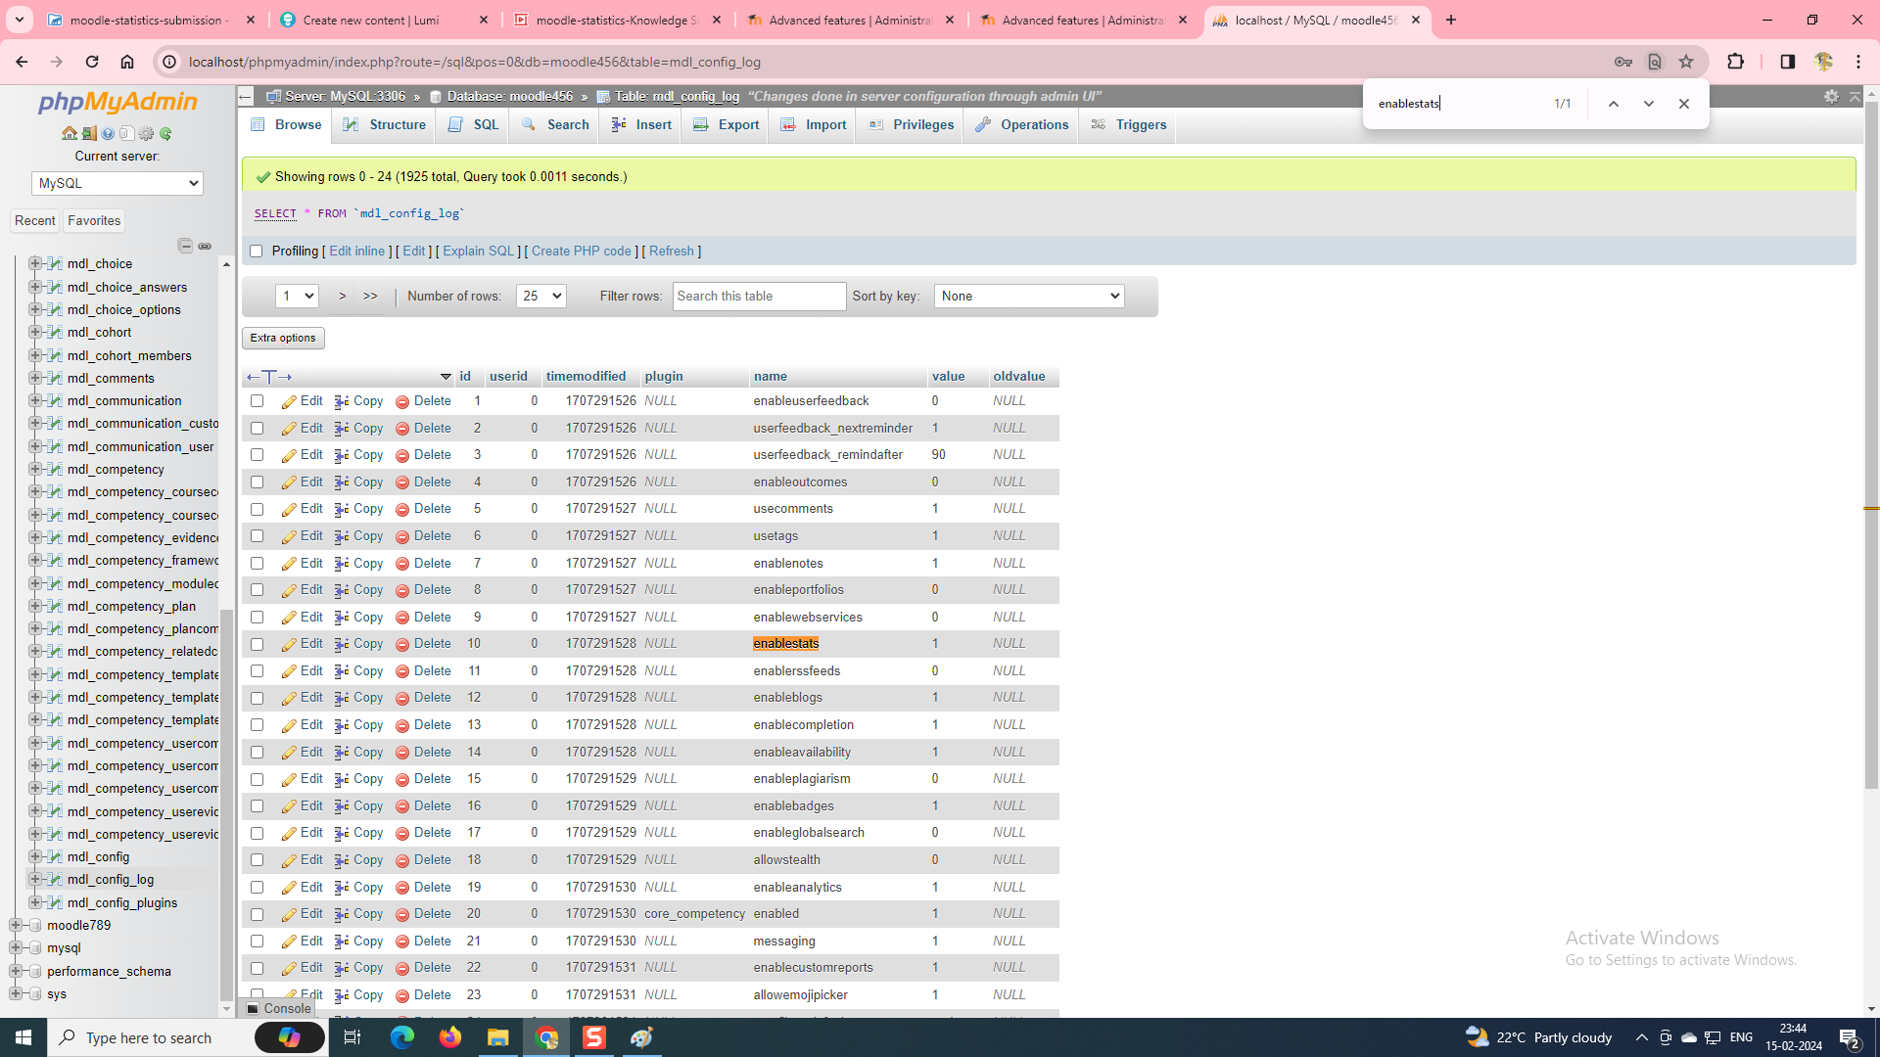
Then go to phpmyadmin and export database.
Open database in editplus and search enablestats, check in which file it is available.
Go to phpmyadmin respected file make enablestats is enable(like 0 to 1)

Slide 11
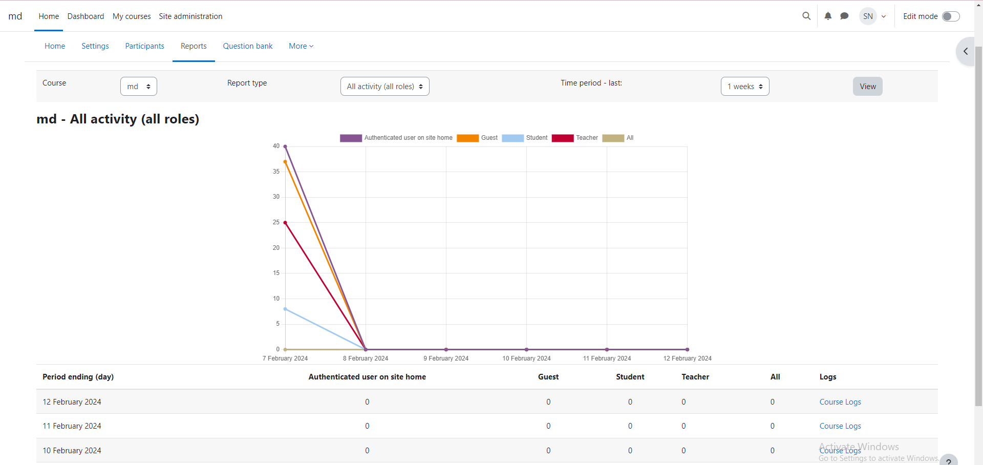
Outcome graph

Slide 12
Steps to how to install external plugin for to see the users course consumption graph
Go to site administration/users/upload users then go to courses/create new courses.
Download zip file: report_coursestats_moodle41_2020070900
Extract it and copy inside folder.
Import/paste: localserver/www/moodle/report
Then go to site administration/reports/statistics and see in reports in the form of graph.

Slide 13
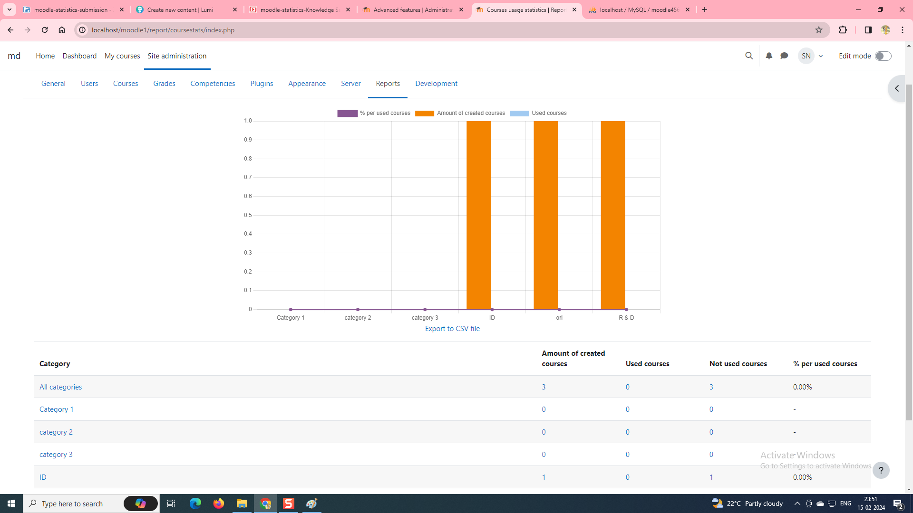
Outcome graph: users courses consumption

Slide 14
To run Moodle(User manager) software uses tools:
Wamp server
Editpluse
Phpmyadmin
MySQL

Slide 15
In conclusion
Moodle is a platform for online learning that enables you to create online courses, add assignments, and keep an track of your students' progress through the graphs. It also allows you to communicate with the students and encourage communication between them in forums and discussions.

Slide 16
Thank you

